Slide 1
Bug Bounty Hunting for Companies & Researchers
Bounty Hunting in Sudan and Abroad
By:
Mazin Ahmed
@mazen160
mazin AT mazinahmed DOT net

Slide 2
WHO AM I?
Mazin Ahmed
Freelancing Information Security Specialist / Penetration Tester
Freelancing Security Researcher at Bugcrowd, Inc
Security Contributor at ProtonMail
Interested in web-security, networks-security, WAF evasions, mobile-security, responsible disclosure, and software automation.
One of top 50 researchers at Bugcrowd out of 37,000+ researchers.
Acknowledged by Facebook, Twitter, Oracle, LinkedIn, and many…
You can read more at https://mazinahmed.net

Slide 3

WHO AM I?
And I have contributed to the security of the following:

Slide 4

AGENDA
MY STORY
RESPONSIBLE DISCLOSURE PROGRAM VS. BUG BOUNTY PROGRAM
WHAT ARE BUG BOUNTY PROGRAM?
BUG BOUNTY PLATFORMS PROCESS
WHAT HAPPENS AFTER STARTING BUG BOUNTY
BUG BOUNTY PROGRAM (HISTORY)
COMMON PITFALLS/MISTAKES
WHY BUG BOUNTY PROGRAMS?
COOL FINDINGS
POPULAR BUG BOUNTY PLATFORMS
INFOSEC, BUG HUNTING IN SUDAN & THE MIDDLE EAST
SELF-HOSTED BUG BOUNTY PROGRAM
ACKNOWLEDGEMENTS
TIPS & NOTES
QUESTIONS

Slide 5
My Story
[My Story]

Slide 6
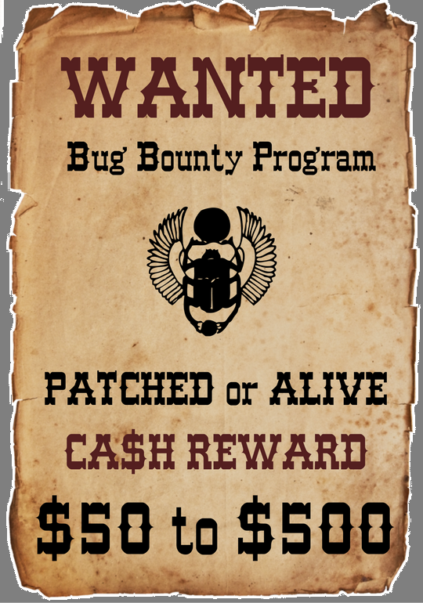
What are Bug Bounty Programs?

Slide 7

Bug bounty Programs (History)

Slide 8
Why Bug Bounty Programs?

Slide 9
Why Bug Bounty Programs? (Company’s Wise)

Slide 10
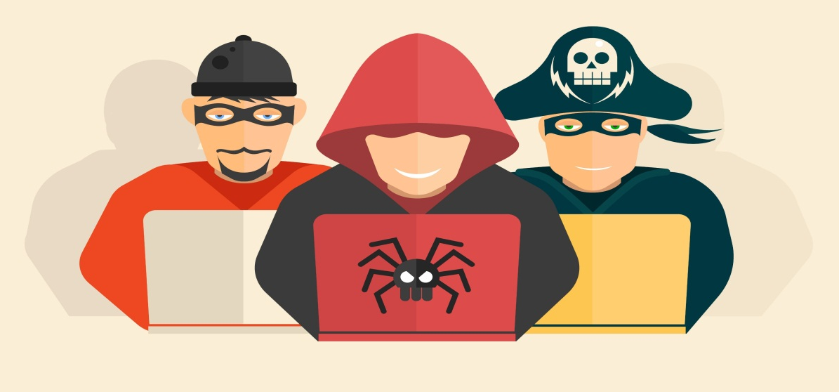
Why Bug Bounty Programs? (Researcher’s Wise)

Slide 11
Popular Bug Bounty Platforms

Slide 12

Popular Bug Bounty Platforms Bugcrowd
First ever public bug bounty platform.
37,000+ researchers/hackers.
Largest-ever security team.
Offers managed – unmanaged - on-going - time-limited – public - private bug bounties.

Slide 13
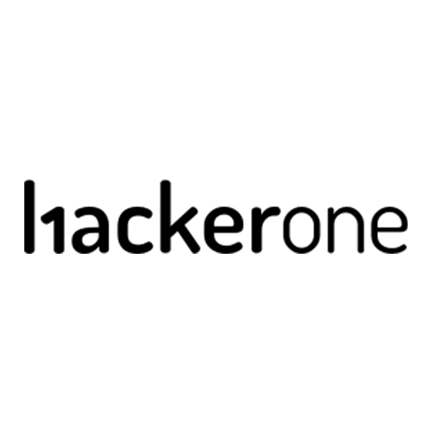
Popular Bug Bounty Platforms Hacker One
A “security inbox” for companies, and a bug bounty platform.
The client handles the submissions validating process.
Around 3700 researchers were thanked in the platform.

Slide 14

Popular Bug Bounty Platforms Synack
Only hires the best of best.
requiring written exams, practical exams, and background-checks for researchers.
Larger payouts than its competitors.
Private number of researchers, private clients.

Slide 15

Popular Bug Bounty Platforms Cobalt.IO
Bug Bounty Platform + Crowdsourced
Pentesting Services.
Different pentesting + bounties services.
A team of 5000 researchers, 200 vetted researchers, 329 submitted valid reports.

Slide 16

Popular Bug Bounty Platforms ZeroCopter
Amsterdam-based bug bounty platform.
Invite-only platform for researchers.
Around 100 chosen researchers.
Handles all reports (aka managed bounty programs).
Run scanners on systems to find hanging fruits before launching the program.

Slide 17
Self-Hosted Bug Bounty Program
Can be done by handling reports by emails, forms, etc...
Less opportunity of having hackers noticing it, (unless the company is very well-known)
Example: Facebook, Google, PayPal, United Airlines)
Bugcrowd hosts a list of self-hosted bounty programs
https://bugcrowd.com/list-of-bug-bounty-programs
https://firebounty.com

Slide 18
Tips & Notes

Slide 19
Tips & Notes
for Companies

Slide 20
Tips & Notes (for Companies)
Bug Bounties do not replace traditional security assessment.
Before getting into bug bounties:
Evaluate your systems and networks.
Perform internal vulnerability assessments
Fix everything!

Slide 21
Tips & Notes (for Companies)
Vs
Vs
Responsible
Disclosure Program
Bug Bounty Program

Slide 22
Tips & Notes (for Companies)
Write an explicit and clear bounty brief.
When getting into bug bounties
check with bug bounty platforms support.
[Preferably] Start with a bug bounty platform.

Slide 23
Tips for Companies (After Establishing Bug Bounty Program)

Slide 24
Bug Bounty Platforms Process
[Bug Bounty Platforms Process]

Slide 25
What Happens after Starting Bug Bounty?
[What Happens after Starting Bug Bounty?]

Slide 26
Tips for Companies (After Establishing Bug Bounty Program)
When you receive a submission, respond with an acknowledgment.
Payouts are vital part!
Try to fix issues ASAP.

Slide 27
Tips & Notes
for Researchers

Slide 28

Tips & Notes (for Researchers)

Slide 29
Common Pitfalls/Mistakes

Slide 30
Common Pitfalls/Mistakes
Bug bounty program is NOT a way to get free or almost-free pentests.

Slide 31
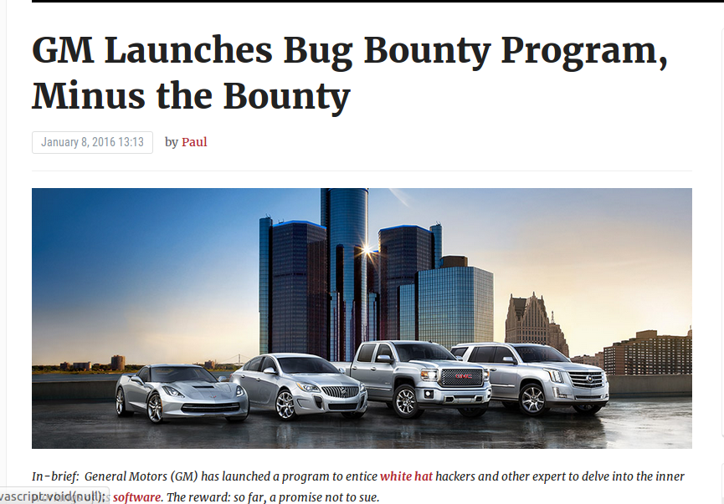
Common Pitfalls/Mistakes

Slide 32
Common Pitfalls/Mistakes
Not paying researchers, while having a full bounty program, aka playing dodgy with researchers.
Some companies actually do that!
Example: Yandex

Slide 33
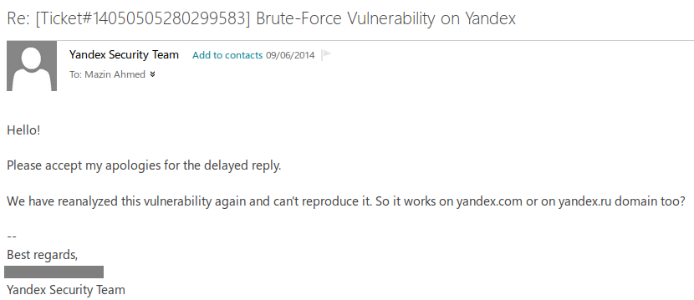
Common Pitfalls/Mistakes
Example: Yandex
Check: http://www.rafayhackingarticles.net/2012/10/yandex-bug-bounty-program-is-it-worth.html

Slide 34
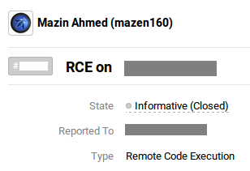
Common Pitfalls/Mistakes
Internal Policies Issues
To fix or not? to reward or not??

Slide 35
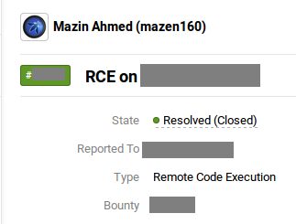
Common Pitfalls/Mistakes
Internal Policies Issues

Slide 36
Cool Findings “The Fun Part”
☺
Cool Findings
“The Fun Part”

Slide 37
Cool Findings Target: SwissCom
Why?
Because we are in Switzerland!

Slide 38
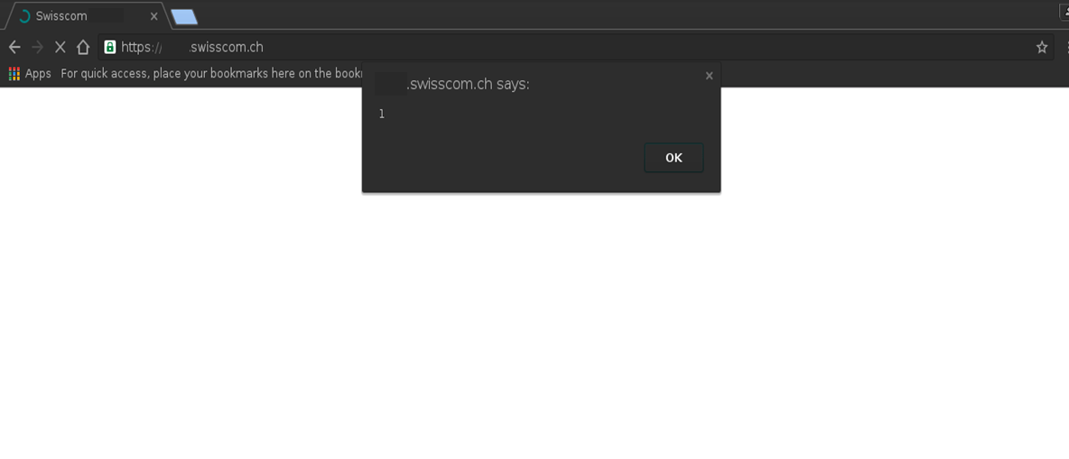
Cool Findings Target: SwissCom

Slide 39
Cool Findings Target: Symantec
One day, I woke-up, and I said to myself, let’s hack Symantec!
Of course, Symantec has a responsible disclosure policy that I follow.

Slide 40
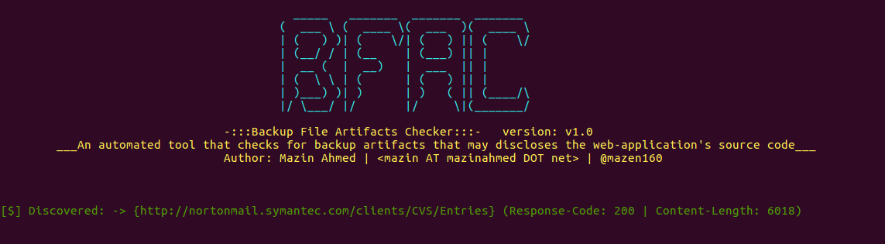
Cool Findings Target: Symantec
Bug #1: Backup-File Artifacts on nortonmail.Symantec.com

Slide 41
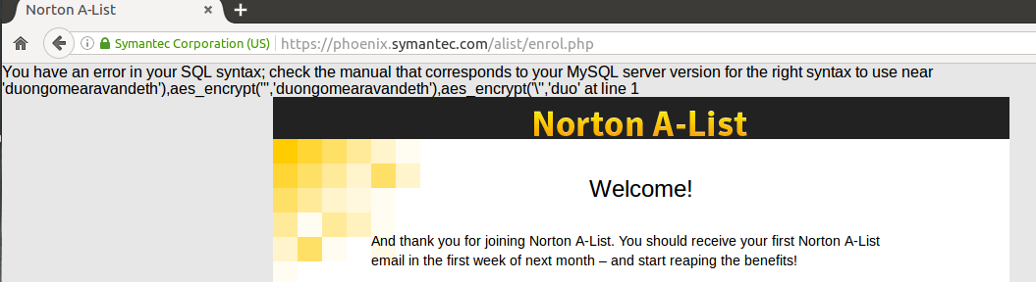
Cool Findings Target: Symantec
Bug #2: Multiple SQL Injection Vulnerabilities
#1

Slide 42
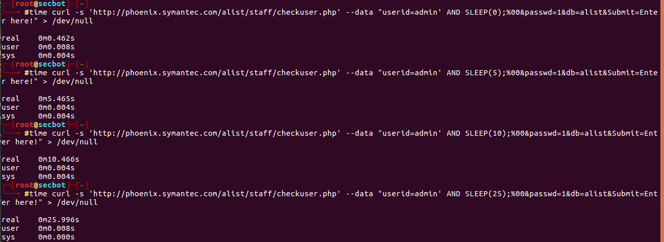
Cool Findings Target: Symantec
Bug #2: Multiple SQL Injection Vulnerabilities
#2

Slide 43
Cool Findings Target: Symantec
Plan
There was a CMS on the same web environment
Exploit SQLI
Get password
Access the CMS as Admin
Reverse TCP connection to my box
DONE
Dumb the DB
Crack (if hashed)
Upload a web-shell
Get root (the server used deprecated and vulnerable kernel)
Report it to vendor.

Slide 44
Cool Findings Target: Symantec
Executing the Plan
Found that I have access to 61 databases!
I Immediately stopped, and report it without exploitation.
Just imagine if I was a bad guy

Slide 45
InfoSec, Bug Hunting in Sudan & the Middle East

Slide 46
InfoSec, Bug Hunting in Sudan & the Middle East
How is it like to be a bug bounty hunter from the middle east?
How is the knowledge level in IT security in the Middle-East?

Slide 47
InfoSec, Bug Hunting in Sudan & the Middle East
How powerful are Arabian BlackHat Hackers?
When it comes to defacing public property, they get crazy.
Motivated by: politics, human-rights, money, and ego.
Seriously, don’t underestimate their powers, don’t mess with them, you won’t like the outcome!
Note: I do not support any form of unethical hacking by no means

Slide 48
Acknowledgements
Christian Folini - @ChrFolini
Bernhard Tellenbach
@SwissCyberStorm Team
and everyone for attending and listening!

Slide 49
Questions?
Mazin Ahmed
Twitter: @mazen160
Email: mazin AT mazinahmed DOT net
Website: https://mazinahmed.net
LinkedIn: https://linkedin.com/in/infosecmazinahmed

